Slide 1
Standard Scores
Psychometrics from the Ground Up
W. Joel Schneider
Department of Psychology
Illinois State University

Slide 2
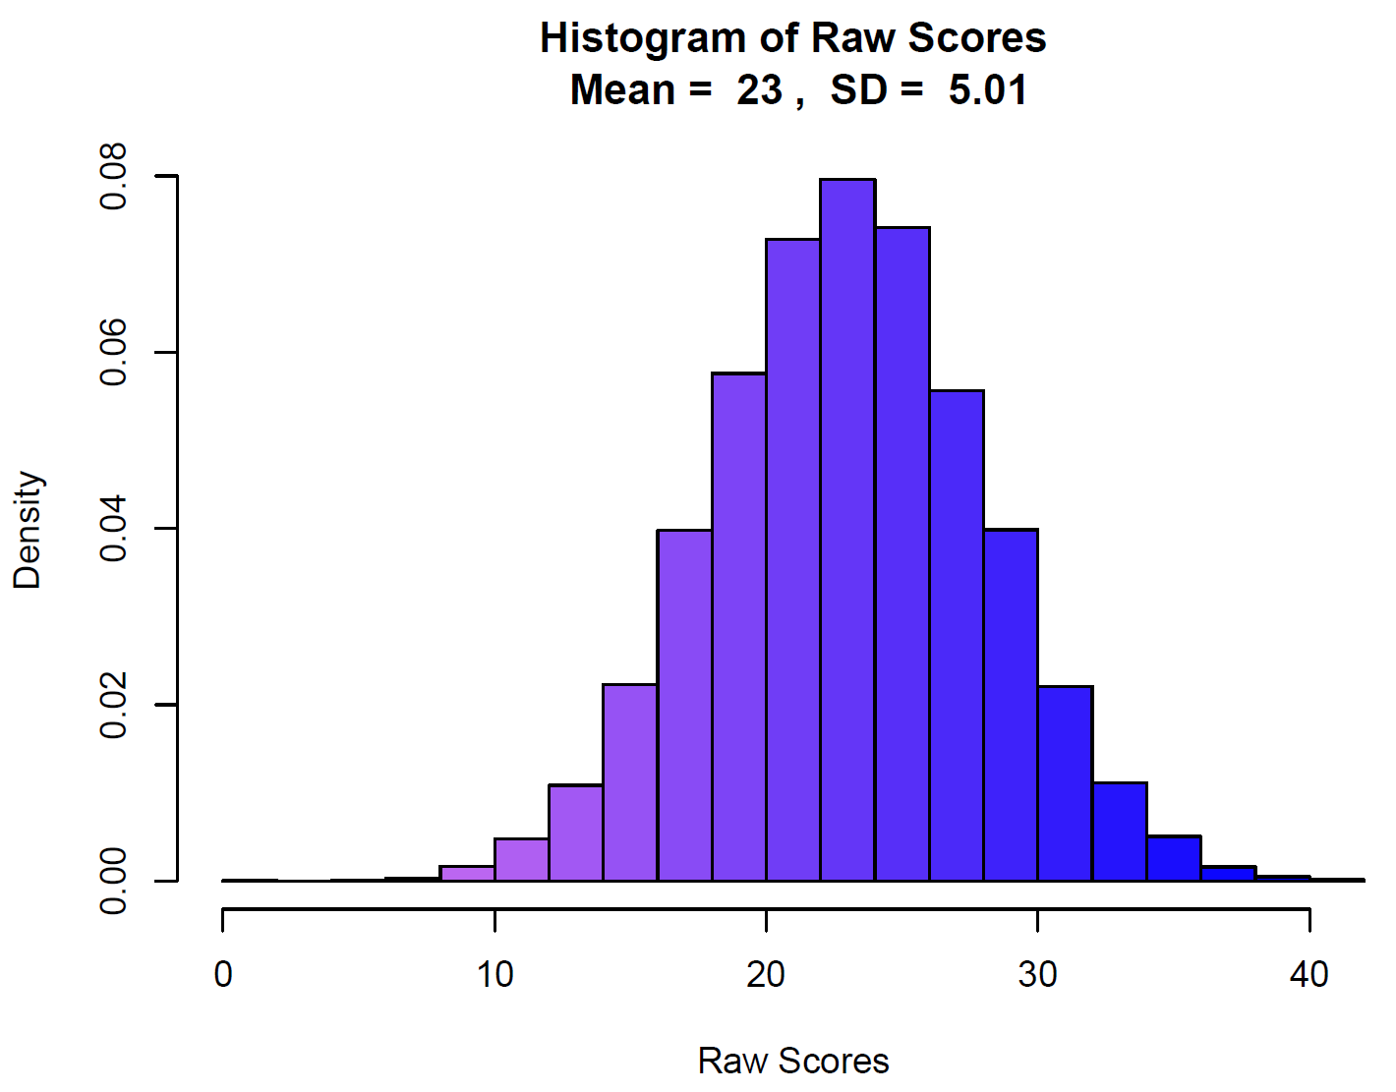

Slide 3
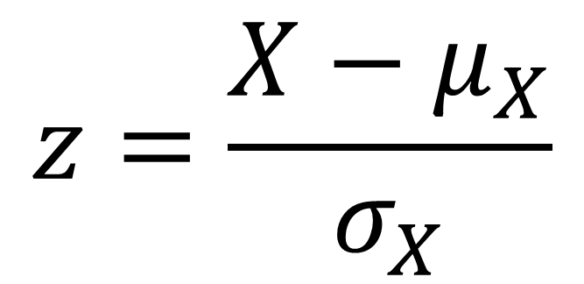
Standardizing Variables
$$z=\frac{X−μ_{X}}{σ_{X}}$$

Slide 4
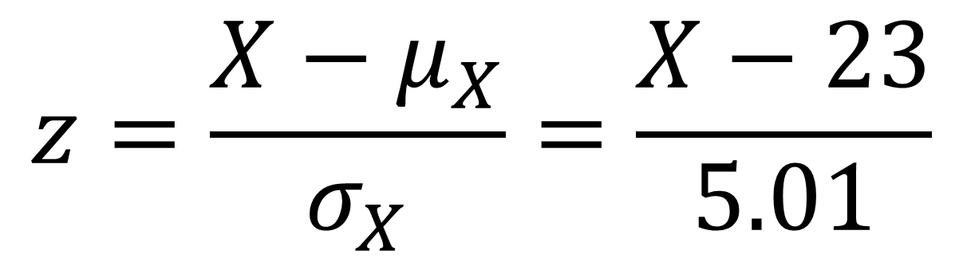
Standardizing Variables
$$z=\frac{X−μ_{X}}{σ_{X}}=\frac{X−23}{5.01}$$

Slide 5
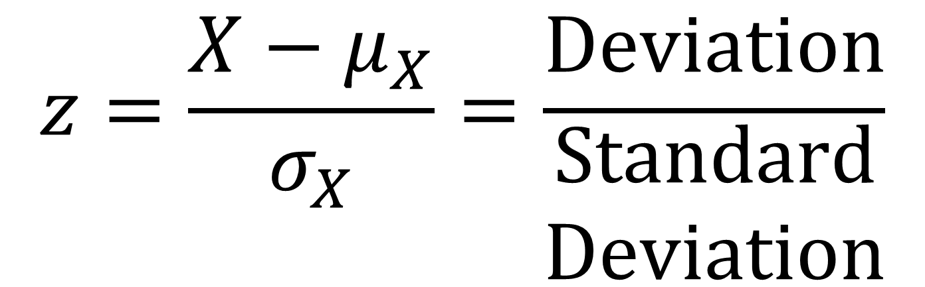
Standardizing Variables
Observed distance
from the mean
$$z=\frac{X−μ_{X}}{σ_{X}}=\frac{Deviation}{\begin{aligned}Standard \\ Deviation\end{aligned}}$$
Typical distance
from the mean

Slide 6
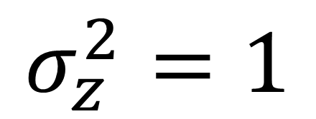
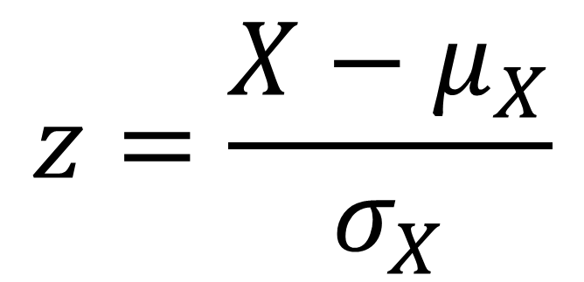
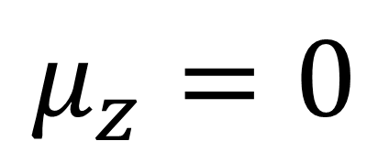
Standardizing Variables
$$z=\frac{X−μ_{X}}{σ_{X}}$$
$$μ_{z}=0$$
$$σ_{z}^{2}=1$$

Slide 7
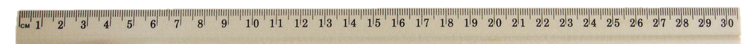
The object is 15.97cm long.
2.01
4.92
7.56
10.32
13.23
15.97
18.51
21.11
23.65
25.72
27.84

Slide 8
0
1
2
3
4
5
6
7
8

Slide 9
0
1
2
3
4
5
6
7
8
9
10
11
12
13
14
15
16

Slide 10
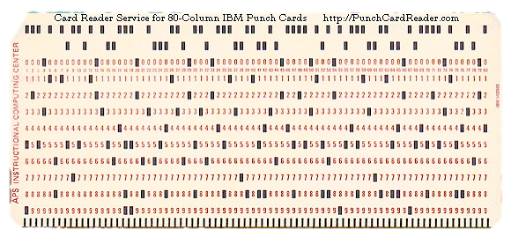
Stanines (μ = 5, σ = 2)
Each stanine = ½ SD

Slide 11
Sten (μ = 5.5, σ = 2)
Each sten = ½ SD

Slide 12
Scaled Score (μ = 10, σ = 3)
Each scaled score = ⅓ SD

Slide 14
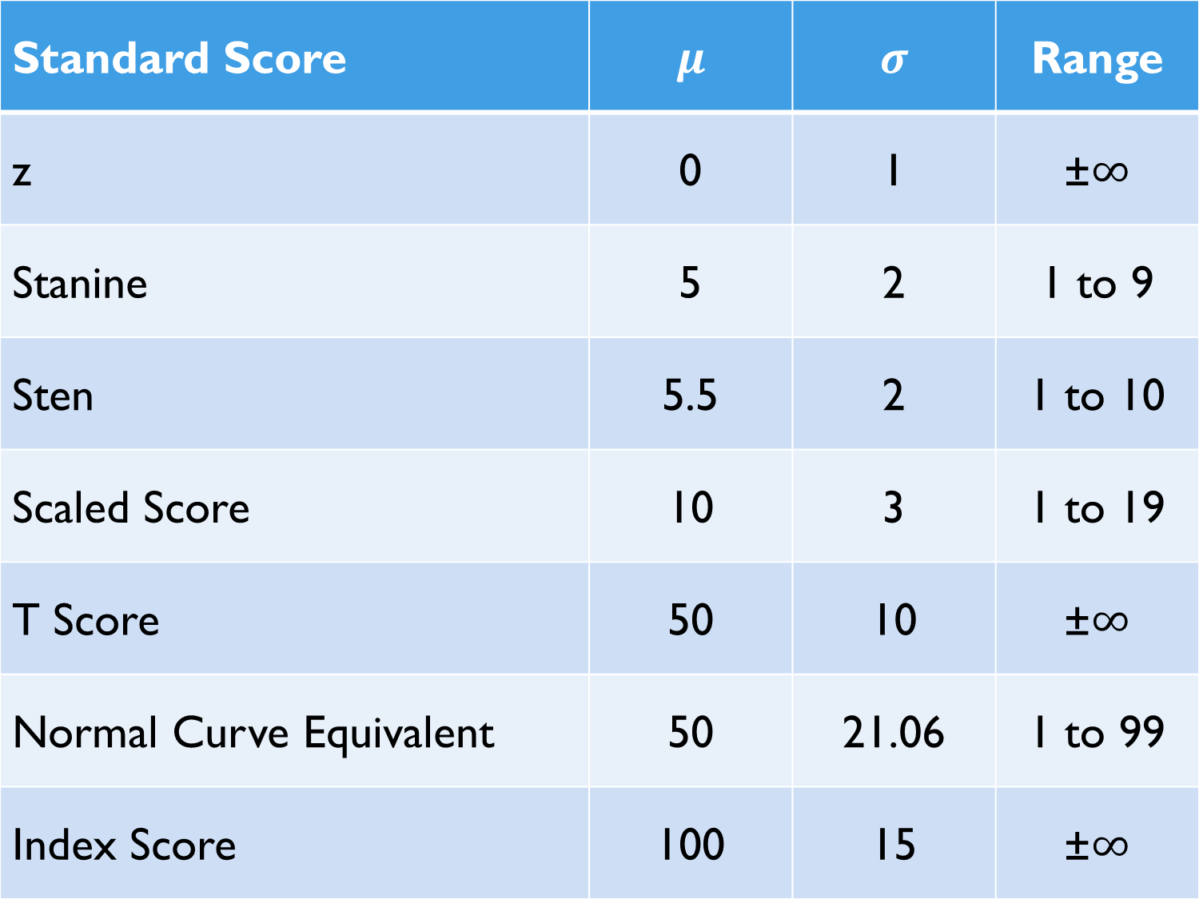
Standard Score | $$μ$$ | $$σ$$ | Range
z | 0 | 1 | ±∞
Stanine | 5 | 2 | 1 to 9
Sten | 5.5 | 2 | 1 to 10
Scaled Score | 10 | 3 | 1 to 19
T Score | 50 | 10 | ±∞
Normal Curve Equivalent | 50 | 21.06 | 1 to 99
Index Score | 100 | 15 | ±∞

Slide 15
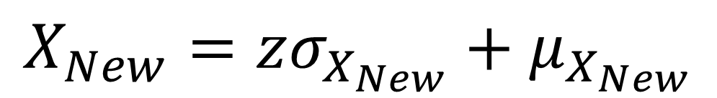

Converting Among Standard Scores
Convert old score to z score.
Convert z score to new score.
$$z=\frac{X_{Old}−μ_{X_{Old}}}{σ_{X_{Old}}}$$
$$X_{New}=zσ_{X_{New}}+μ_{X_{New}}$$

Slide 16
Convert a Scaled Score of 15 to an Index Score
Convert scaled score to z score.
Convert z score to index score.
$$z=\frac{X_{Old}−μ_{X_{Old}}}{σ_{X_{Old}}}$$
$$X_{New}=zσ_{X_{New}}+μ_{X_{New}}$$

Slide 17

Convert a Scaled Score of 15 to an Index Score
Convert scaled score to z score.
Convert z score to index score.
$$z=\frac{15−μ_{X_{Old}}}{σ_{X_{Old}}}$$
$$X_{New}=zσ_{X_{New}}+μ_{X_{New}}$$

Slide 18

Convert a Scaled Score of 15 to an Index Score
Convert scaled score to z score.
Convert z score to index score.
$$z=\frac{15−10}{σ_{X_{Old}}}$$
$$X_{New}=zσ_{X_{New}}+μ_{X_{New}}$$

Slide 19

Convert a Scaled Score of 15 to an Index Score
Convert scaled score to z score.
Convert z score to index score.
$$z=\frac{5}{σ_{X_{Old}}}$$
$$X_{New}=zσ_{X_{New}}+μ_{X_{New}}$$

Slide 20

Convert a Scaled Score of 15 to an Index Score
Convert scaled score to z score.
Convert z score to index score.
$$z=\frac{5}{3}$$
$$X_{New}=zσ_{X_{New}}+μ_{X_{New}}$$

Slide 21
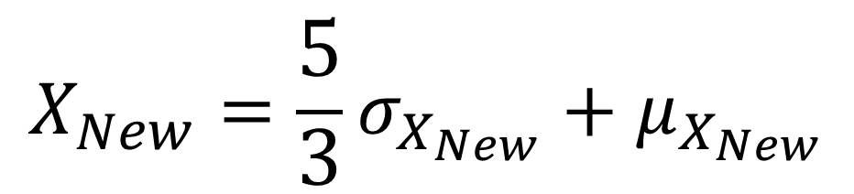
Convert a Scaled Score of 15 to an Index Score
Convert scaled score to z score.
Convert z score to index score.
$$z=\frac{5}{3}$$
$$X_{New}=\frac{5}{3}σ_{X_{New}}+μ_{X_{New}}$$

Slide 22
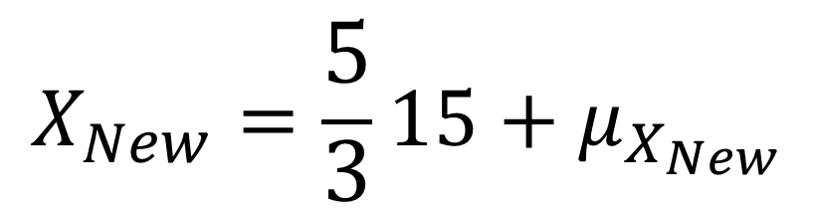
Convert a Scaled Score of 15 to an Index Score
Convert scaled score to z score.
Convert z score to index score.
$$z=\frac{5}{3}$$
$$X_{New}=\frac{5}{3}15+μ_{X_{New}}$$

Slide 23
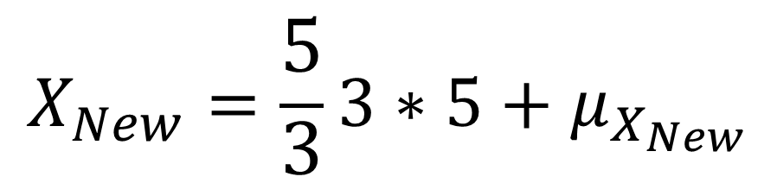
Convert a Scaled Score of 15 to an Index Score
Convert scaled score to z score.
Convert z score to index score.
$$z=\frac{5}{3}$$
$$X_{New}=\frac{5}{3}3∗5+μ_{X_{New}}$$

Slide 24
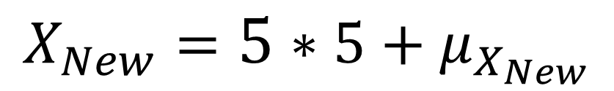
Convert a Scaled Score of 15 to an Index Score
Convert scaled score to z score.
Convert z score to index score.
$$z=\frac{5}{3}$$
$$X_{New}=5∗5+μ_{X_{New}}$$

Slide 25
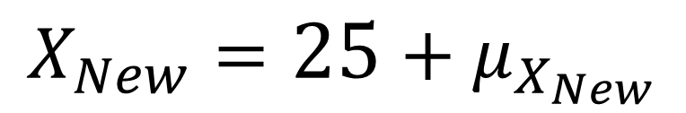
Convert a Scaled Score of 15 to an Index Score
Convert scaled score to z score.
Convert z score to index score.
$$z=\frac{5}{3}$$
$$X_{New}=25+μ_{X_{New}}$$

Slide 26
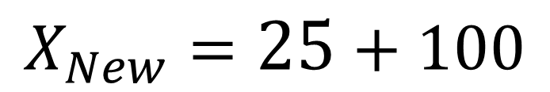
Convert a Scaled Score of 15 to an Index Score
Convert scaled score to z score.
Convert z score to index score.
$$z=\frac{5}{3}$$
$$X_{New}=25+100$$

Slide 27
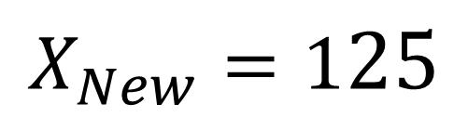
Convert a Scaled Score of 15 to an Index Score
Convert scaled score to z score.
Convert z score to index score.
$$z=\frac{5}{3}$$
$$X_{New}=125$$

Slide 28
Convert an Index Score of 72 to a T Score
Convert index score to z score.
Convert z score to T score.
$$z=\frac{X_{Old}−μ_{X_{Old}}}{σ_{X_{Old}}}$$
$$X_{New}=zσ_{X_{New}}+μ_{X_{New}}$$

Slide 29

Convert an Index Score of 72 to a T Score
Convert index score to z score.
Convert z score to T score.
$$z=\frac{72−μ_{X_{Old}}}{σ_{X_{Old}}}$$
$$X_{New}=zσ_{X_{New}}+μ_{X_{New}}$$

Slide 30

Convert an Index Score of 72 to a T Score
Convert index score to z score.
Convert z score to T score.
$$z=\frac{72−100}{σ_{X_{Old}}}$$
$$X_{New}=zσ_{X_{New}}+μ_{X_{New}}$$

Slide 31

Convert an Index Score of 72 to a T Score
Convert index score to z score.
Convert z score to T score.
$$z=\frac{−28}{σ_{X_{Old}}}$$
$$X_{New}=zσ_{X_{New}}+μ_{X_{New}}$$

Slide 32

Convert an Index Score of 72 to a T Score
Convert index score to z score.
Convert z score to T score.
$$z=\frac{−28}{15}$$
$$X_{New}=zσ_{X_{New}}+μ_{X_{New}}$$

Slide 33

Convert an Index Score of 72 to a T Score
Convert index score to z score.
Convert z score to T score.
$$z=\frac{−28}{15}$$
$$X_{New}=\frac{−28}{15}σ_{X_{New}}+μ_{X_{New}}$$

Slide 34

Convert an Index Score of 72 to a T Score
Convert index score to z score.
Convert z score to T score.
$$z=\frac{−28}{15}$$
$$X_{New}=\frac{−28}{15}10+μ_{X_{New}}$$

Slide 35

Convert an Index Score of 72 to a T Score
Convert index score to z score.
Convert z score to T score.
$$z=\frac{−28}{15}$$
$$X_{New}=\frac{−28}{3}2+μ_{X_{New}}$$

Slide 36
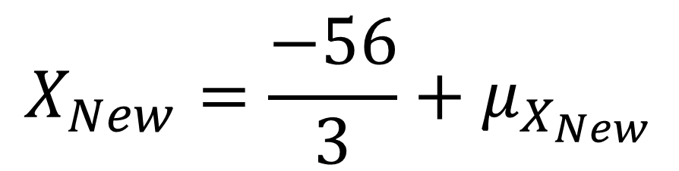
Convert an Index Score of 72 to a T Score
Convert index score to z score.
Convert z score to T score.
$$z=\frac{−28}{15}$$
$$X_{New}=\frac{−56}{3}+μ_{X_{New}}$$

Slide 37

Convert an Index Score of 72 to a T Score
Convert index score to z score.
Convert z score to T score.
$$z=\frac{−28}{15}$$
$$X_{New}=−18\frac{2}{3}+μ_{X_{New}}$$

Slide 38
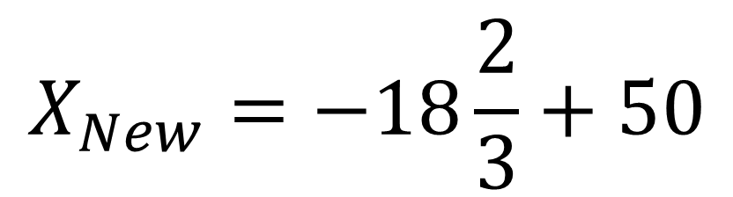
Convert an Index Score of 72 to a T Score
Convert index score to z score.
Convert z score to T score.
$$z=\frac{−28}{15}$$
$$X_{New}=−18\frac{2}{3}+50$$

Slide 39

Convert an Index Score of 72 to a T Score
Convert index score to z score.
Convert z score to T score.
$$z=\frac{−28}{15}$$
$$X_{New}=31\frac{1}{3}$$

Slide 40
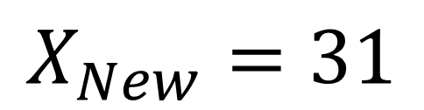
Convert an Index Score of 72 to a T Score
Convert index score to z score.
Convert z score to T score.
$$z=\frac{−28}{15}$$
$$X_{New}=31$$

Slide 41
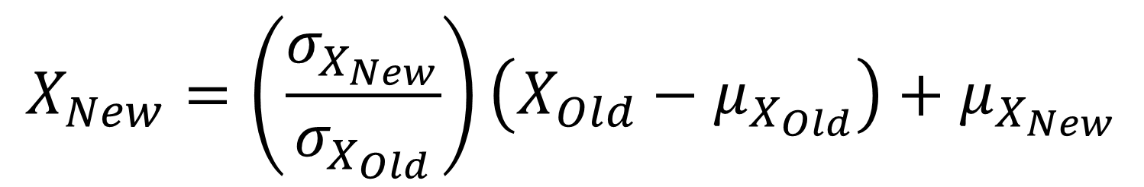
Converting Among Standard Scores
$$X_{New}=\left(\frac{σ_{X_{New}}}{σ_{X_{Old}}}\right)\left(X_{Old}−μ_{X_{Old}}\right)+μ_{X_{New}}$$

Slide 42
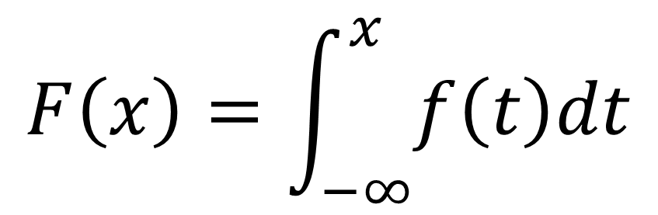
Cumulative Distribution Function (CDF)
A function that tells us the proportion of a distribution that is less than or equal to a given number.
If F(x) is the CDF and f(x) is the PDF, then
$$F\left(x\right)=\int_{−∞}^{x}{f\left(t\right)dt}$$

Slide 43
Index Score | Scaled Score | Percentile
145 | 19 | 99.9
140 | 18 | 99.6
135 | 17 | 99
130 | 16 | 98
125 | 15 | 95
120 | 14 | 91
115 | 13 | 84
110 | 12 | 75
105 | 11 | 63
100 | 10 | 50
95 | 9 | 37
90 | 8 | 25
85 | 7 | 16
80 | 6 | 9
75 | 5 | 5
70 | 4 | 2
65 | 3 | 1
60 | 2 | .4
55 | 1 | .1

Slide 44
T-Score | Percentile
80 | 99.9
75 | 99.4
70 | 98
65 | 93
60 | 84
55 | 69
50 | 50
45 | 31
40 | 16
35 | 7
30 | 2
25 | .6
20 | .1

Slide 45
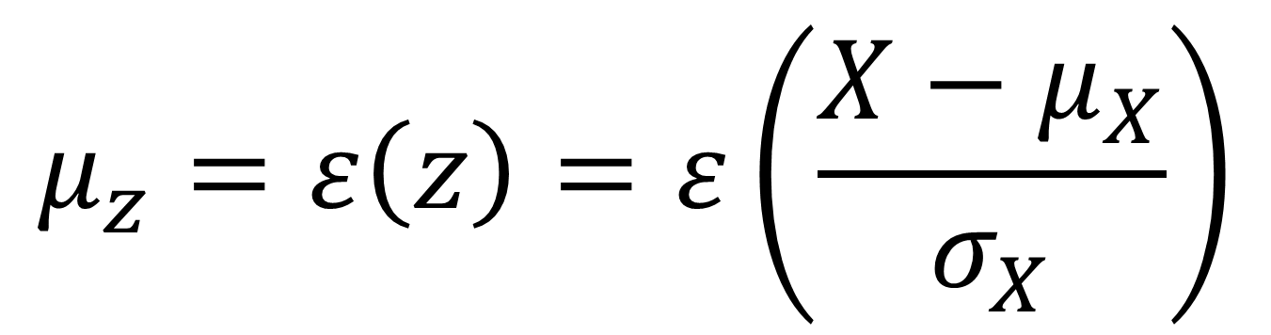
Standardizing Variables
$$μ_{z}=ε\left(z\right)=ε\left(\frac{X−μ_{X}}{σ_{X}}\right)$$

Slide 46
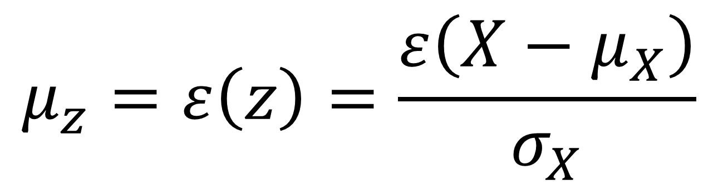
Standardizing Variables
$$μ_{z}=ε\left(z\right)=\frac{ε\left(X−μ_{X}\right)}{σ_{X}}$$

Slide 47
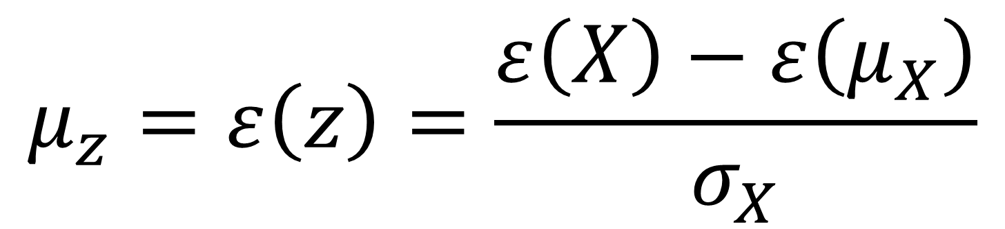
Standardizing Variables
$$μ_{z}=ε\left(z\right)=\frac{ε\left(X\right)−ε\left(μ_{X}\right)}{σ_{X}}$$

Slide 48
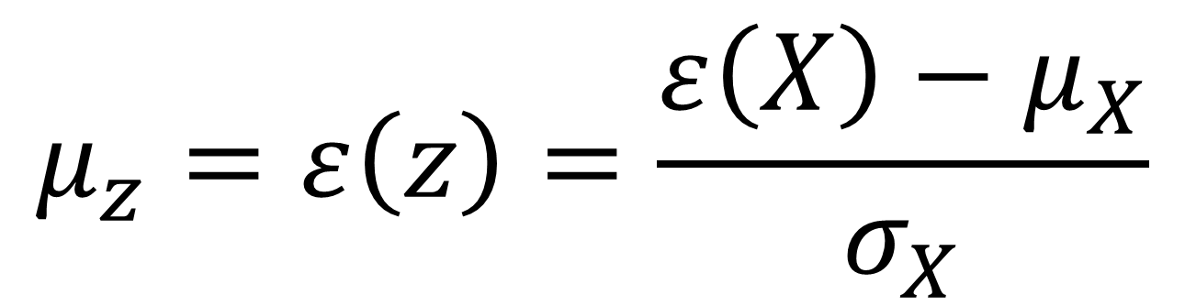
Standardizing Variables
$$μ_{z}=ε\left(z\right)=\frac{ε\left(X\right)−μ_{X}}{σ_{X}}$$

Slide 49
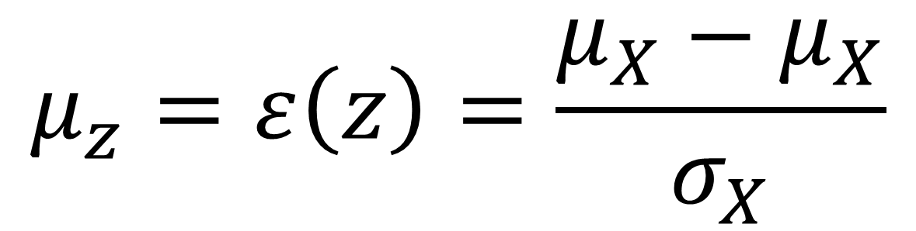
Standardizing Variables
$$μ_{z}=ε\left(z\right)=\frac{μ_{X}−μ_{X}}{σ_{X}}$$

Slide 50
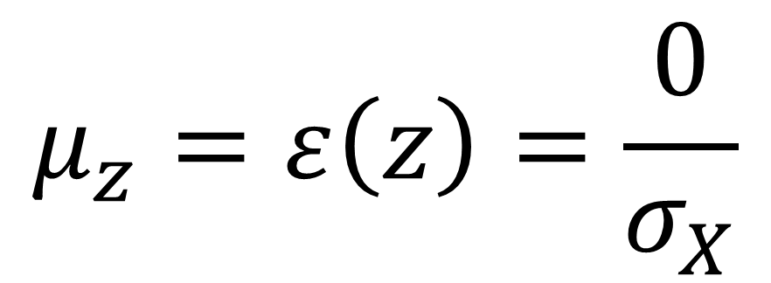
Standardizing Variables
$$μ_{z}=ε\left(z\right)=\frac{0}{σ_{X}}$$

Slide 51
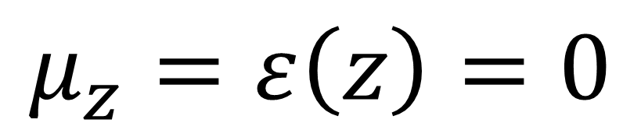
Standardizing Variables
$$μ_{z}=ε\left(z\right)=0$$

Slide 52
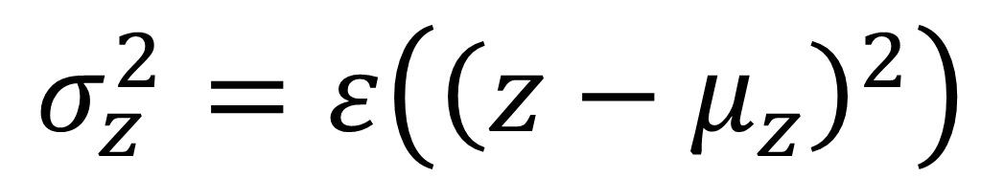
Standardizing Variables
$$σ_{z}^{2}=ε\left({\left(z−μ_{z}\right)}^{2}\right)$$

Slide 53
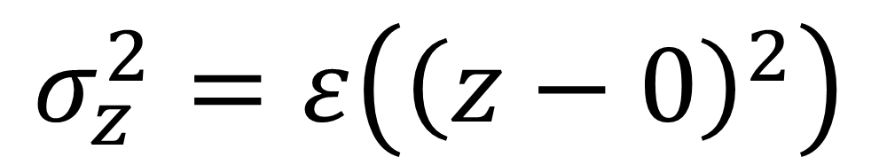
Standardizing Variables
$$σ_{z}^{2}=ε\left({\left(z−0\right)}^{2}\right)$$

Slide 54
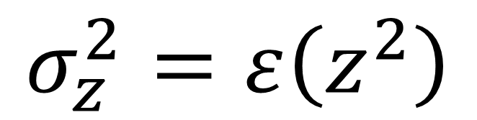
Standardizing Variables
$$σ_{z}^{2}=ε\left(z^{2}\right)$$

Slide 55
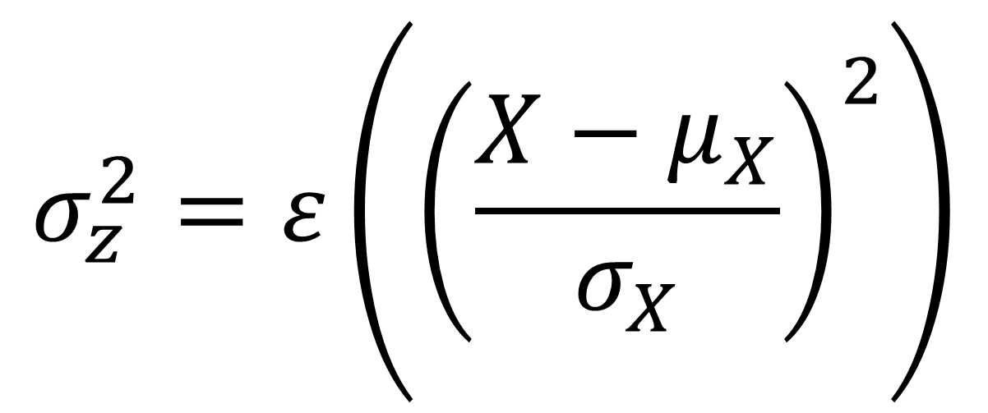
Standardizing Variables
$$σ_{z}^{2}=ε\left({\left(\frac{X−μ_{X}}{σ_{X}}\right)}^{2}\right)$$

Slide 56
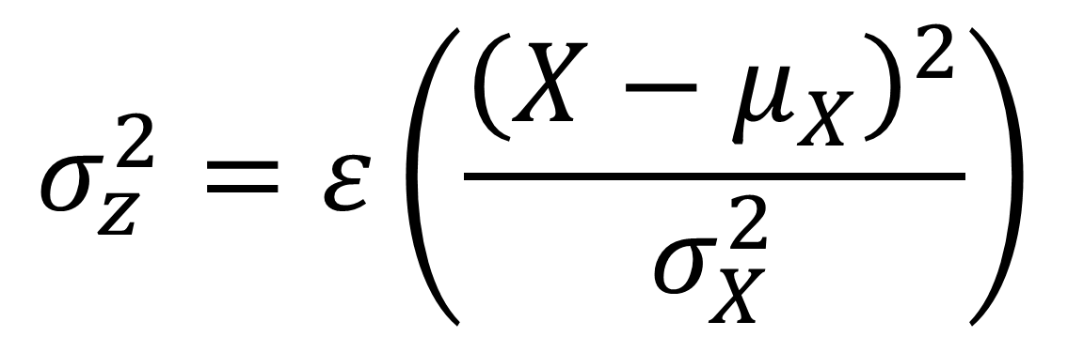
Standardizing Variables
$$σ_{z}^{2}=ε\left(\frac{{\left(X−μ_{X}\right)}^{2}}{σ_{X}^{2}}\right)$$

Slide 57
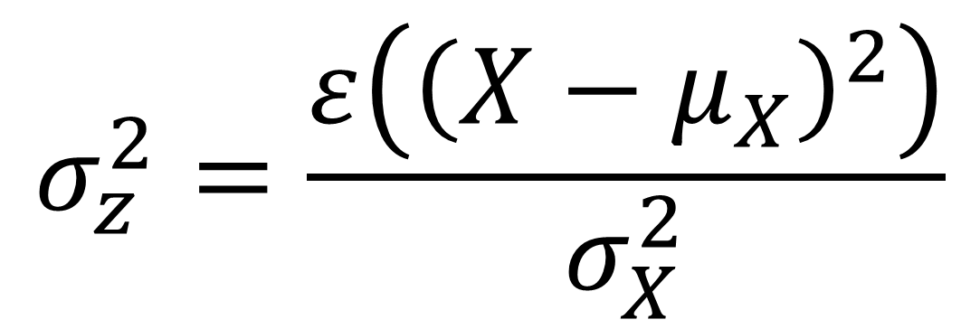
Standardizing Variables
$$σ_{z}^{2}=\frac{ε\left({\left(X−μ_{X}\right)}^{2}\right)}{σ_{X}^{2}}$$

Slide 58
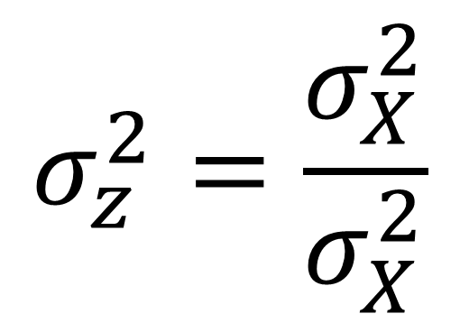
Standardizing Variables
$$σ_{z}^{2}=\frac{σ_{X}^{2}}{σ_{X}^{2}}$$

Slide 59
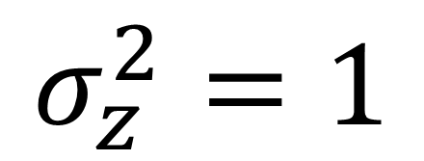
Standardizing Variables
$$σ_{z}^{2}=1$$

